Slide 1
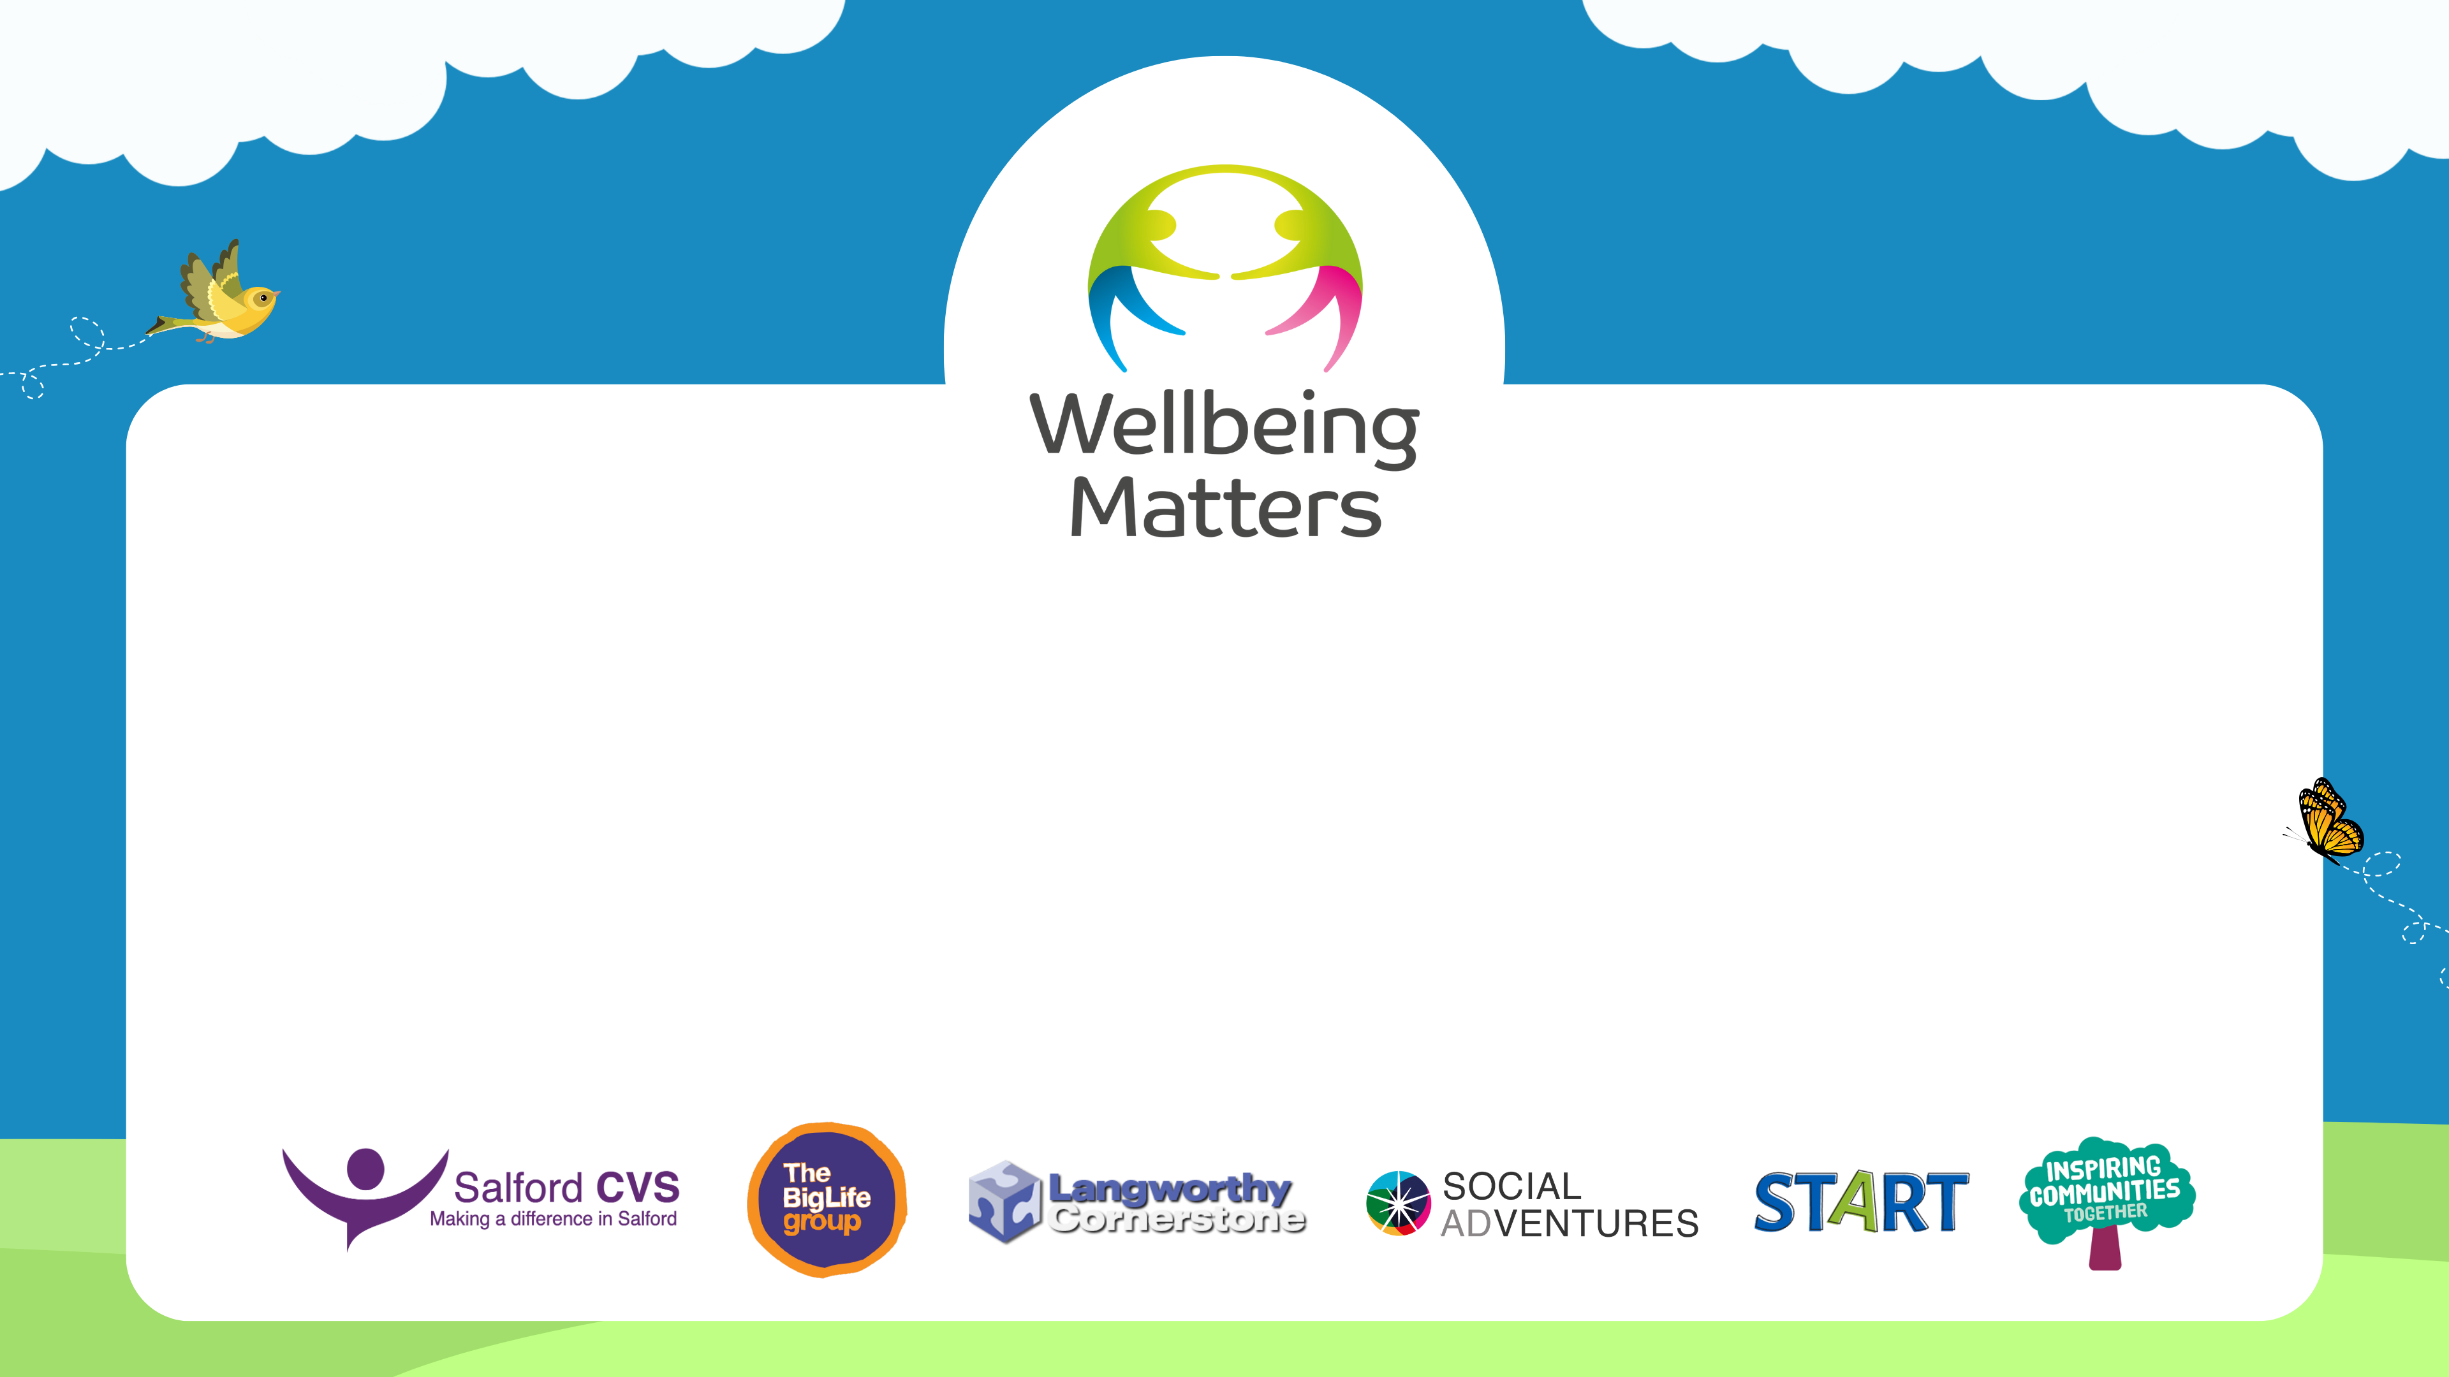
Wellbeing Matters
Social Prescribing

Slide 2

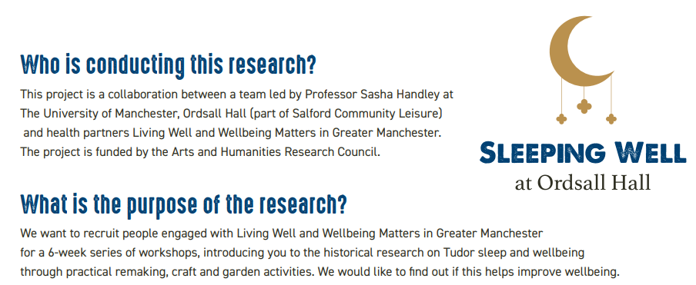


Wellbeing Matters’ outcomes
Our development worker team supported a new sleep well project with capacity building support and feedback.
‘Emma and Nosheela have attended workshops and provide us with continual pointers and feedback which have been gratefully received. We hope to build on our work together with another round of Sleeping Well creative health sessions with existing and new participants and are keen on providing a legacy from the project with Wellbeing Matters though various self-led creative health resources.’ Dr Anna Fielding, Project Officer, Ordsall Hall and the University of Manchester

Slide 3
Wellbeing Matters case study
Anxiety and sleep support
[Terry] was referred by St Andrews MP to Wellbeing Matters after previous engagement with the programme in 2022, for anxiety. [Terry] has struggled with his mental and physical health and had recently finished attending sessions at START. He explained that as the course started to come to an end, it has triggered his anxiety and depression. He was worried that he would be unable to fill his time with something that he enjoyed and that he would be set back to how he felt before attending START.
After initial discussions on his anxiety and trouble sleeping, [Terry] his Community Connector suggested few options and then supported [Terry] to the Sleep Well programme at Ordsall Hall.
[Terry] attended the sleep well sessions and became more comfortable and engaged in the sessions. [Terry] linked in with our Wellbeing Matters development worker Emma. He showed Emma the different techniques that had been taught in the class, and that he had been going home and practicing these. Emma shared she was really inspired by the amazing artwork [Terry] showed me. It was clear that these sessions have re-ignited his passion for being creative and he was session; than ‘just ok at art’. [Terry] said ‘‘I joined my local library a few years ago but I didn’t use it very often, but this has prompted me to go into the library…It’s made me start reading more.’
[Terry] completed the full 6 weeks sessions; He has also signed back up to the next round of the Sleep Well project and as a result has now started to volunteer at Ordsall Hall. When asking [Terry] how the Sleep Well project has affected him, he said ‘It’s made me re-evaluate, that I’ve actually got some self-worth, you know, in me.’

